Slide 1
DATA SCIENCE machine learning / KNN

Slide 2
I. what is machine learning? iI. Supervised Learning III. Unsupervised Learning IV. Summary V. Classification with K-Nearest Neighbors
agenda

Slide 3
I. What is machine learning?
DATA SCIENCE

Slide 4
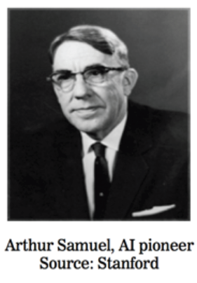
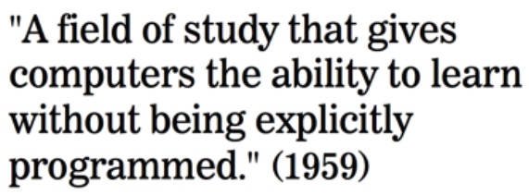
What is machine learning?

Slide 5
What is machine learning?
Machine Learning is a class of algorithms which are data-driven. Unlike classical algorithms, it is the data that defines a “good” answer and NOT the human
Example:
A Non-Machine Learning algorithm might “define” a face as having a roundish structure, two eyes, hair, nose, etc. The algorithm then looks for these “hard-coded” features in test cases.
A Machine Learning algorithm might only be given several pictures of faces and non-faces that are labeled as such. From the examples (called training set) it would “figure out” it’s own definition of a face.

Slide 6
Not Perfect
Machine Learning is generally semi-automatic meaning that intelligent decisions by humans are still necessary

Slide 7


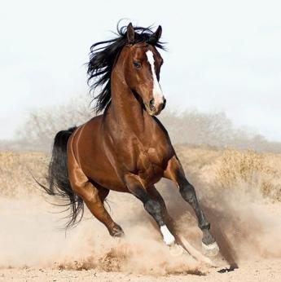
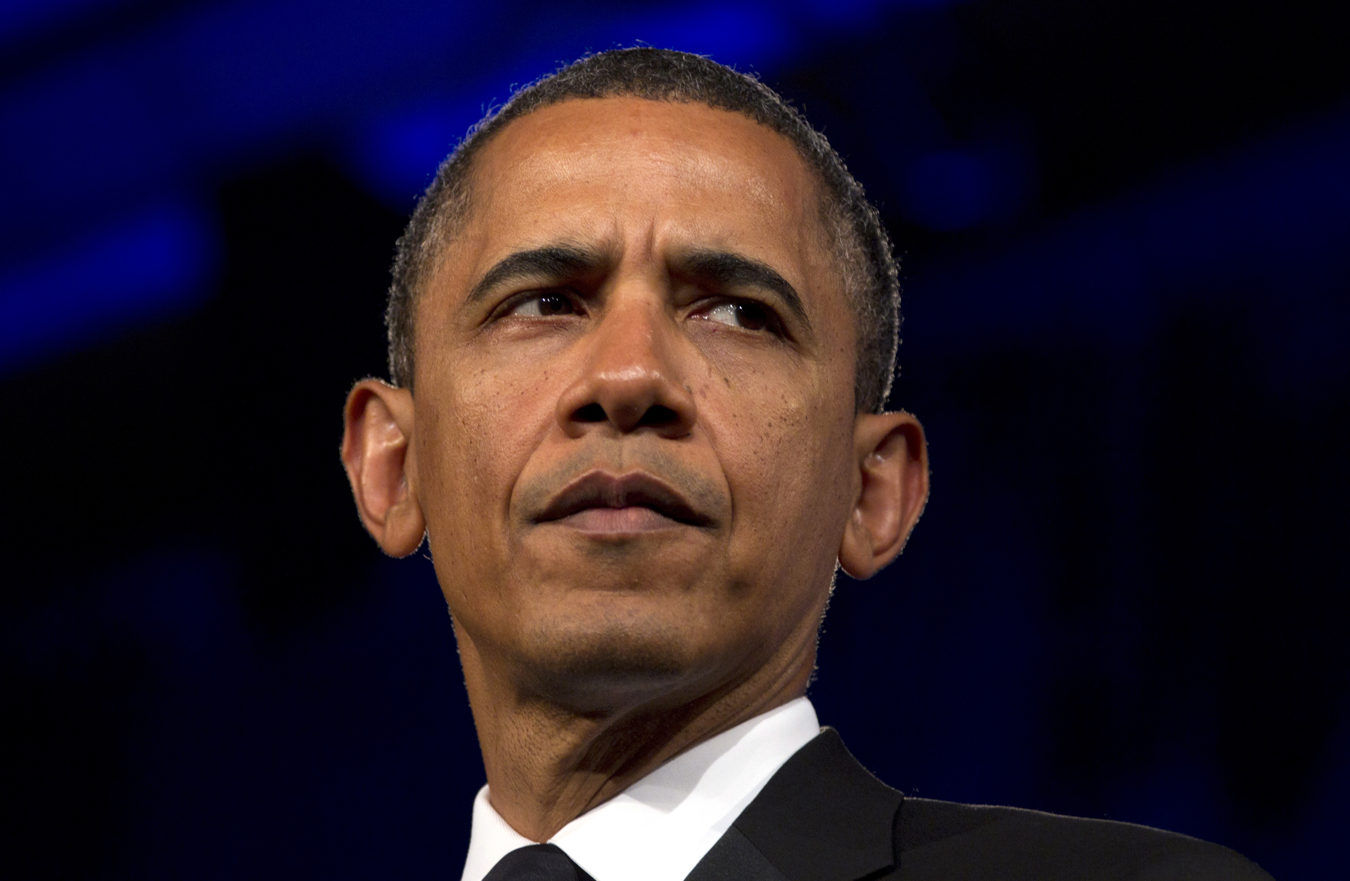
Example: Facial Recognition: Machine Learning
Training set
Test
Face
Face?
Not Face
Face

Slide 8
Types of Machine Learning Problems
supervised making predictions
unsupervised extracting structure

Slide 9

Types of Machine Learning Problems
generalization
supervised making predictions
unsupervised extracting structure
Supervised: labeled data
Unsupervised: unlabeled data
representation

Slide 10
Types of Machine Learning Problems
generalization
supervised making predictions
unsupervised extracting structure
Supervised: labeled data
Unsupervised: unlabeled data
Previous example was supervised!
representation

Slide 11
II. Supervised Learning
DATA SCIENCE

Slide 12
Supervised Learning
All about making predictions
List of “Predictors” X
Also known as features, independent variables, inputs, regressors, covariates, attributes
“Response” y
Also known as outcome, label, target, dependent variable
If y is continuous: Regression
e.g., price, blood pressure
If y is categorical (values in a finite, unordered set): Classification
e.g., spam/ham, digit 0-9, cancer class of tissue sample
Data are composed of “observations” (predictors and the associated response)
Also known as samples, examples, instances, records

Slide 13
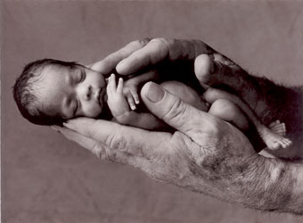
Example #1: Predicting Neonatal Infection
Problem: Children born prematurely are at high risk of developing infections, many of which are not detected until after the baby is sick
Goal: Detect subtle patterns in the data that predicts infection before it occurs
Data: 16 vital signs such as heart rate, respiration rate, blood pressure, etc…
Impact: Model is able to predict the onset of infection 24 hours before the traditional symptoms of infection appear
predictors
Sample response: Did the child develop an infection? True/False
Notes:
Lots of names you’d expect (also obama, nyt → politics = growth area)
Q: can you think of any others? → show some example in the browser
Soon the question will be: who doesn’t use data science?

Slide 14
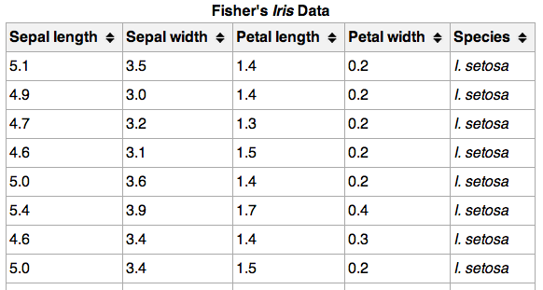
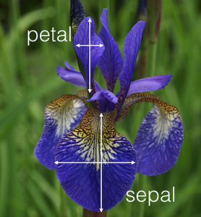
Supervised Learning – Fisher’s Iris
}
150 observations
(n = 150)
{
{
response
4 predictors (p = 4)

Slide 15
Supervised Learning
Supervised Learning uses known/labeled “training cases” in order to:
Accurately predict unseen test cases
Understand which predictors affect the response, and how
Use the past to predict the future

Slide 16
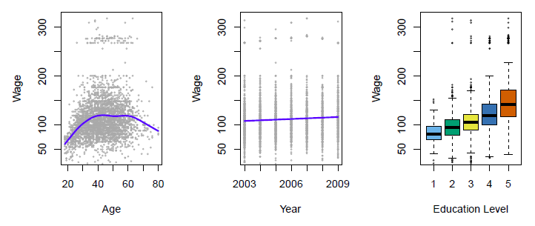
Regression Example
Establish the relationship between salary and demographic variables in population survey data
Income survey data for males from the central Atlantic region of the USA in 2009
Source: https://class.stanford.edu/c4x/HumanitiesScience/StatLearning/asset/introduction.pdf

Slide 17
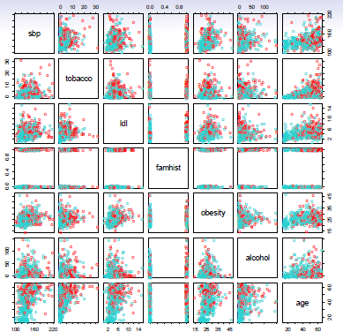
Classification Example
Predict whether someone will have a heart attack on the basis of demographic, diet and clinical measurements
Case-control sample of men from South Africa
Red = heart disease
Blue = no heart disease
Source: https://class.stanford.edu/c4x/HumanitiesScience/StatLearning/asset/introduction.pdf

Slide 18
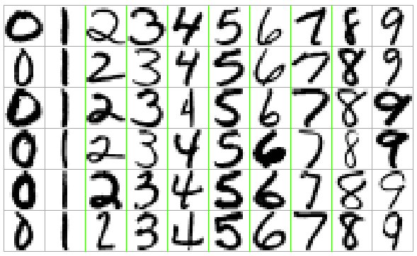
Classification Example
Identify the numbers in a handwritten zip code
Source: https://class.stanford.edu/c4x/HumanitiesScience/StatLearning/asset/introduction.pdf

Slide 19
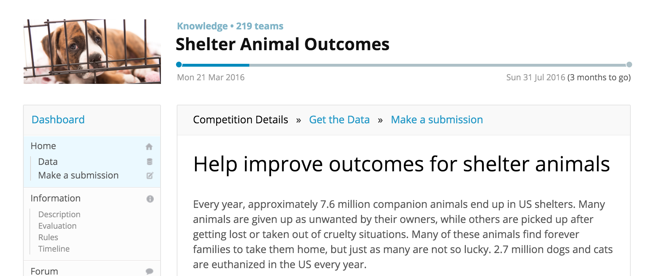
Classification Example: Kaggle

Slide 20
What is kaggle?
Kaggle
Data Science challenges
Mostly a competition involving machine learning
Judged by metrics learned in this class
Some for money, others for knowledge

Slide 21
III. UNSupervised Learning
DATA SCIENCE

Slide 22
UNSupervised Learning
No response variable y, just a set of predictors X
Objective is more open:
Find groups of observations that behave similarly
Find predictors that behave similarly
Find combinations of features that explain the variation in the data
Difficult to evaluate how well you are doing
Data is easier to obtain for unsupervised learning since it can be “unlabeled” (i.e., it hasn’t been labeled with a response)
Sometimes useful as a preprocessing step for supervised learning
Common techniques: clustering, principal components analysis

Slide 23
Supervised Vs. Unsupervised Learning
continuous categorical
supervised regression classification
unsupervised dimension clustering
reduction

Slide 24
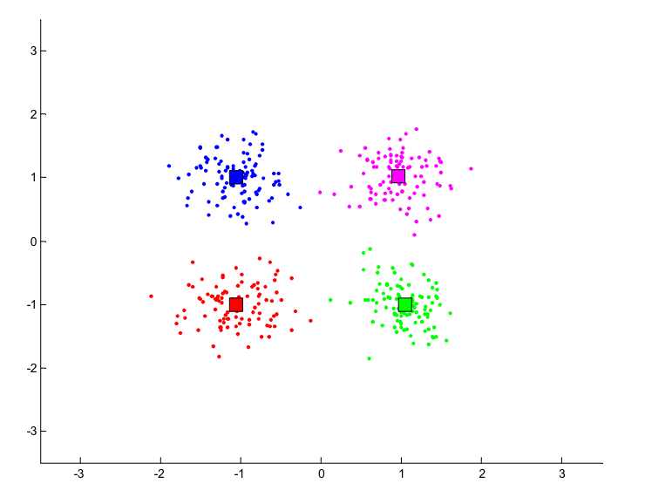
Clustering Example
Source: http://people.cs.pitt.edu/~milos/courses/cs2750-Spring03/lectures/class17.pdf

Slide 25
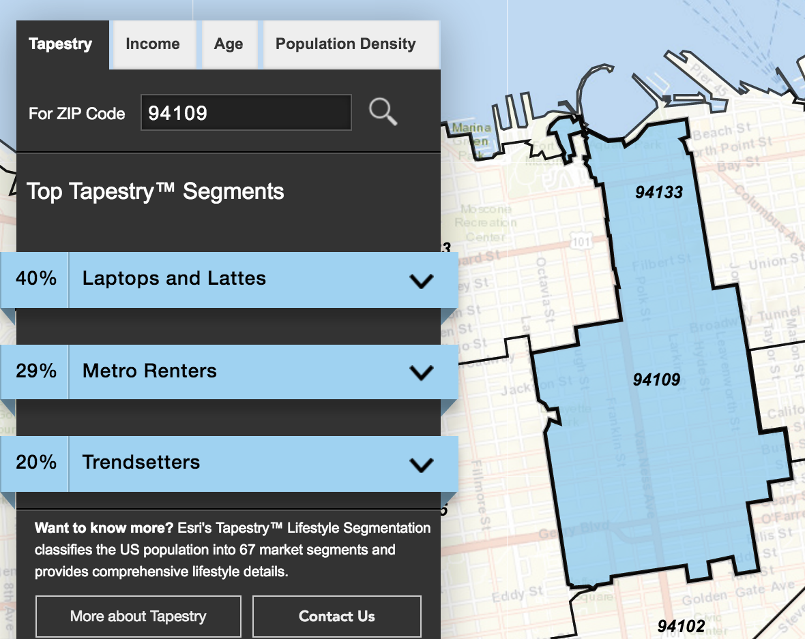
Clustering Example
Classify US residential neighborhoods into 67 unique segments based on demographic and socioeconomic characteristics
Example of cluster: Laptops and Lattes
We're affluent, well-educated singles and partner couples who love life in the big city
Regular expenses include nice clothes, traveling, and treating ourselves to lattes at Starbucks or treatments at spas. Laptops, cell phones, and iPads are always on so we can stay connected.
Leisure time is filled with visiting art galleries and museums; attending the theater, opera, and going to bars and clubs.
Source: http://www.esri.com/landing-pages/tapestry/

Slide 26
IV. Summary
DATA SCIENCE

Slide 27
Supervised Vs. Unsupervised Learning
continuous categorical
supervised regression classification
unsupervised dimension clustering
reduction

Slide 28
V. Classification with K-Nearest Neighbors
DATA SCIENCE

Slide 29
Supervised Vs. Unsupervised Learning
continuous categorical
supervised regression classification
unsupervised dimension clustering
reduction

Slide 30

Supervised Vs. Unsupervised Learning
continuous categorical
supervised regression classification
unsupervised dimension clustering
reduction

Slide 31
Supervised Learning
}
{
150 observations
(n = 150)
{
response
4 predictors (p = 4)

Slide 32
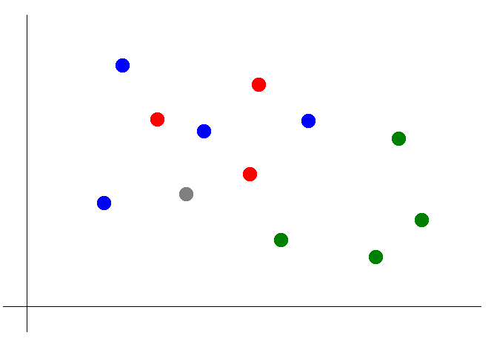
Classification with KNN
Suppose we want to predict the color of the gray dot.
QUESTION:
What are the predictors? What is the response?

Slide 33
Classification with KNN
Suppose we want to predict the color of the gray dot.
Pick a value for k.
k = 3

Slide 34
Classification with KNN
Suppose we want to predict the color of the gray dot.
Pick a value for k.
Find colors of k
nearest neighbors.
k = 3

Slide 35
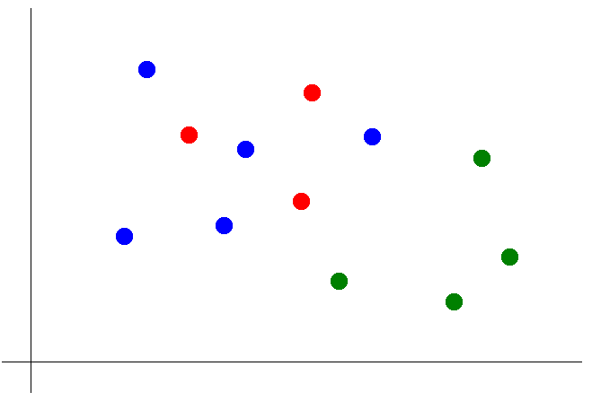
Classification with KNN
Suppose we want to predict the color of the gray dot.
Pick a value for k.
Find colors of k
nearest neighbors.
Assign the most
common color
to the gray dot.

Slide 36
Classification with KNN
Suppose we want to predict the color of the gray dot.
Pick a value for k.
Find colors of k
nearest neighbors.
Assign the most
common color
to the gray dot.
NOTE:
Our definition of “nearest” implicitly uses the Euclidean distance function.

Slide 37
Classification with KNN
Advantages of KNN:
Simple to understand and explain
Model training phase is fast
Non-parametric (does not presume a “form” of the “decision boundary”)
Disadvantages of KNN:
Prediction phase can be slow when n is large
Sensitive to irrelevant features

Slide 38
DATA SCIENCE

